Slide 1


Test Approaches on
DRIVER
Image Placeholder
Rifat Shadman| 29 -September-2023

Slide 2
DRIVER
Project Summary-
The Data for Road Incident Visualization, Evaluation and Reporting (DRIVER) is an open-source system that has been developed, deployed and piloted by the World Bank and GRSF. DRIVER improves data collection, analysis, management and reporting of road crash incidents. Dhaka Metropolitan Police (DMP), as one of the key stakeholders to work with road crash data in Dhaka city have decided to implement the DRIVER for Dhaka City.

Slide 3
DRIVER
Test Plan in a brief-
The testing we did on the DRIVER software mainly focuses on the functional and GUI area of the software.
We tried to ensure that all functional requirements of the DRIVER software are thoroughly tested and meet the specified criteria for correctness and reliability.
We also tried to evaluate the software’s error handling mechanisms and recovery processes to ensure that users informative error messages and that the software can gracefully handle unexpected situations e.g. Duplicate records.
The final goal of this testing process is to ensure over acceptance of the Software to the user, which in this case is Dhaka Metropolitan Police

Slide 4
DRIVER
Module Name | Test Cases | Functional | GUI
Login | 5 | 3 | 2
Dashboard | 21 | 14 | 7
Map | 25 | 21 | 4
My Account | 1 | 1 | 0
Record List | 15 | 11 | 4
Add a Record | 50 | 44 | 6
Manage Duplicate Records | 8 | 5 | 3
Total | 125 | 99 | 26
Test Estimation

Slide 5
Project Time Estimation
Test Execution, Bug Reporting and Retesting Time (Total Man Day): |  |  | 3.5
 | Total Effort (man-day) |  | 9.3
 | Total Effort (man-month) |  | 0.5
Total time required for Test Case preparation, execution, and reporting have been calculated by time constraints that are followed in BJIT company policy.

Slide 6
DRIVER
Test case Preparation and area of coverage
Test cases were broadly categorized into two:
Functional Test Cases
GUI(Graphical User Interface) Test Cases
Area of coverage:
7 Screens
23 Modules
56 Sub-modules

Slide 7
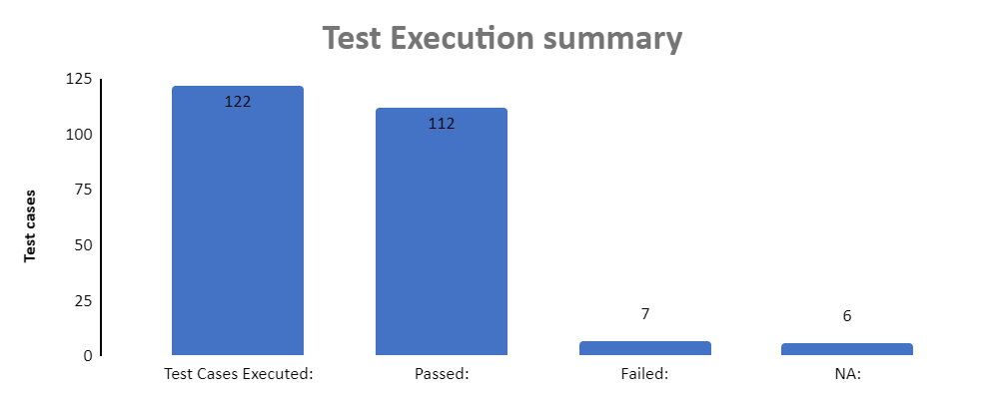
DRIVER
Test Execution and coverage

Slide 8
DRIVER
Test Report/Bug Reporting
We have found 7 bugs in total in our first sprint of testing.
Most of the bugs found during the testing process are minor in nature.
But there were some major bugs.
Date Format was not according to the SRS. Day/Month/Year format has been implemented instead of the required Month/Day/Year format
“Manage Duplicate Records” page failed to load potential duplicate records

Slide 9
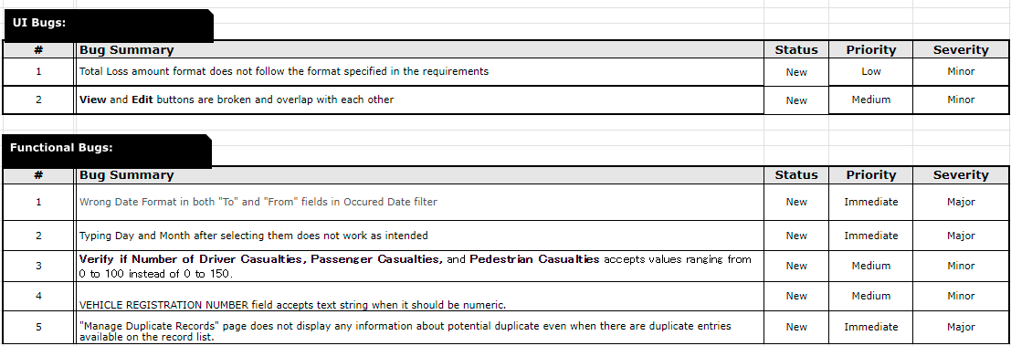

Slide 10
Screen Status
Screen Name | Status
Login | OK
Dashboard | NG
My Account | OK
Map | NG
Record List | NG
Add a Record | NG
Manage Duplicate Records | NG

Slide 11
Thank you

